Slide 1
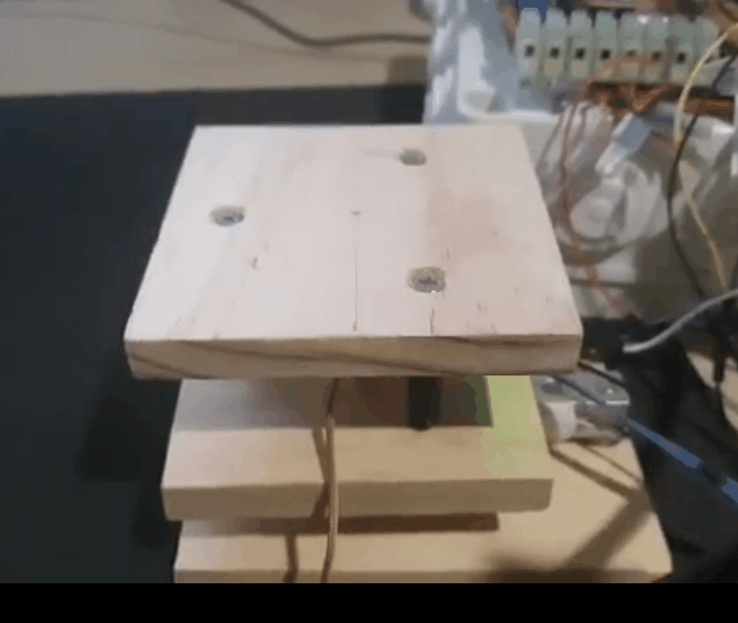
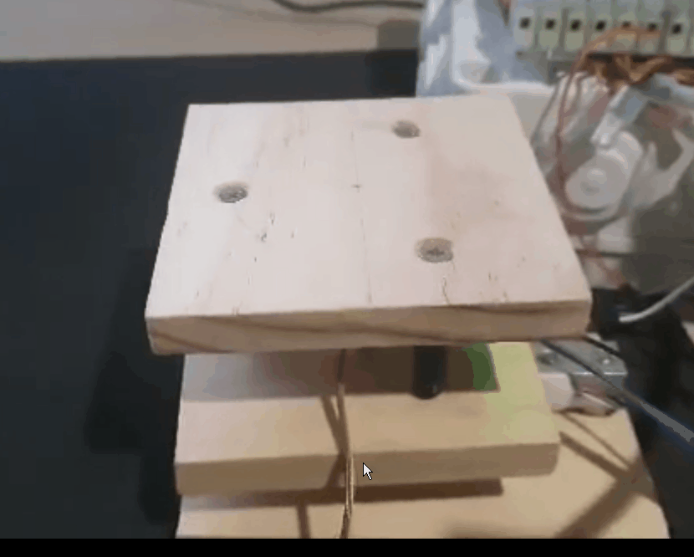
Hardware vs Software
No jittering
Jittering

Slide 2
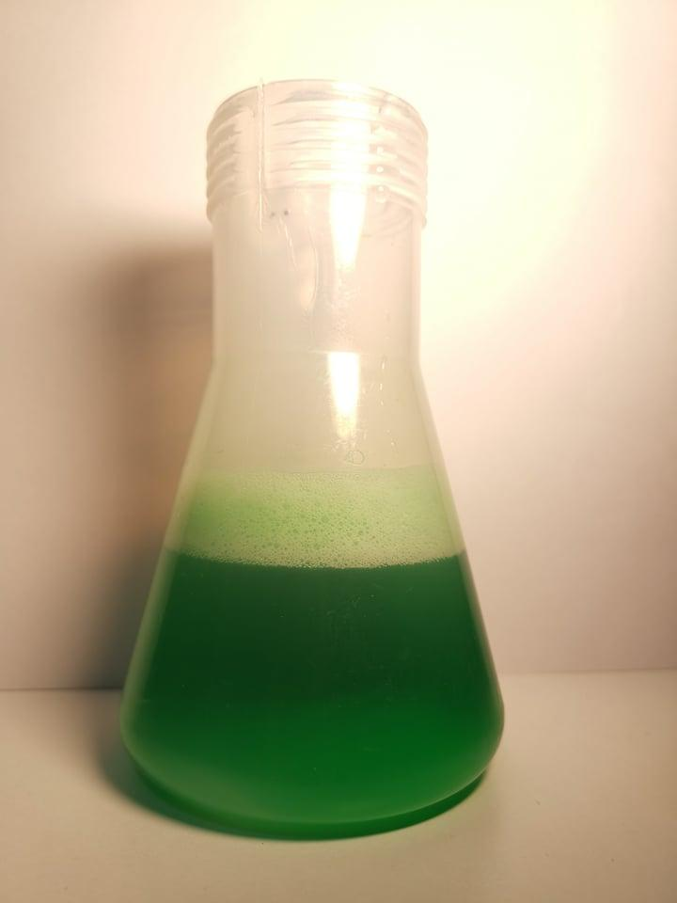
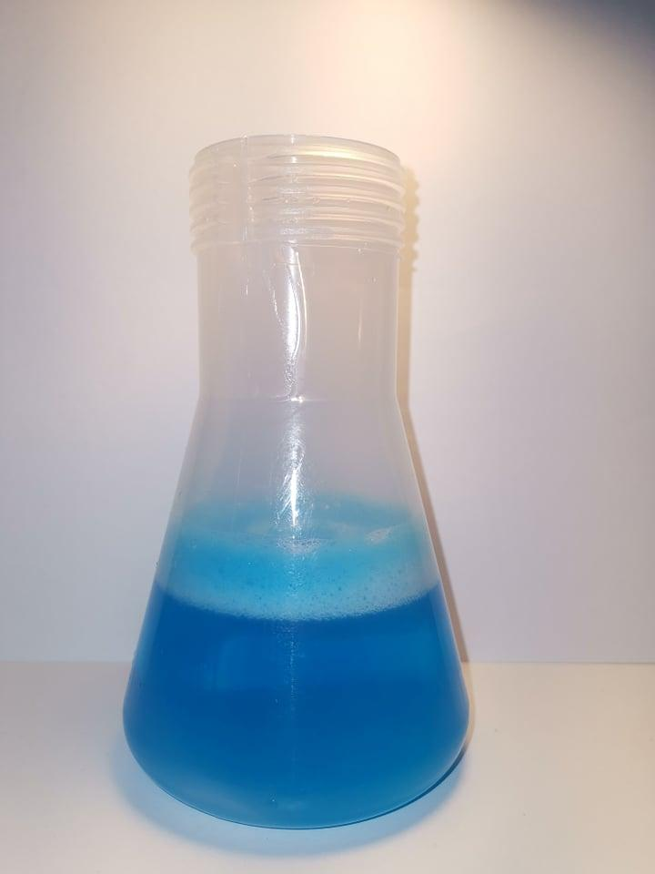
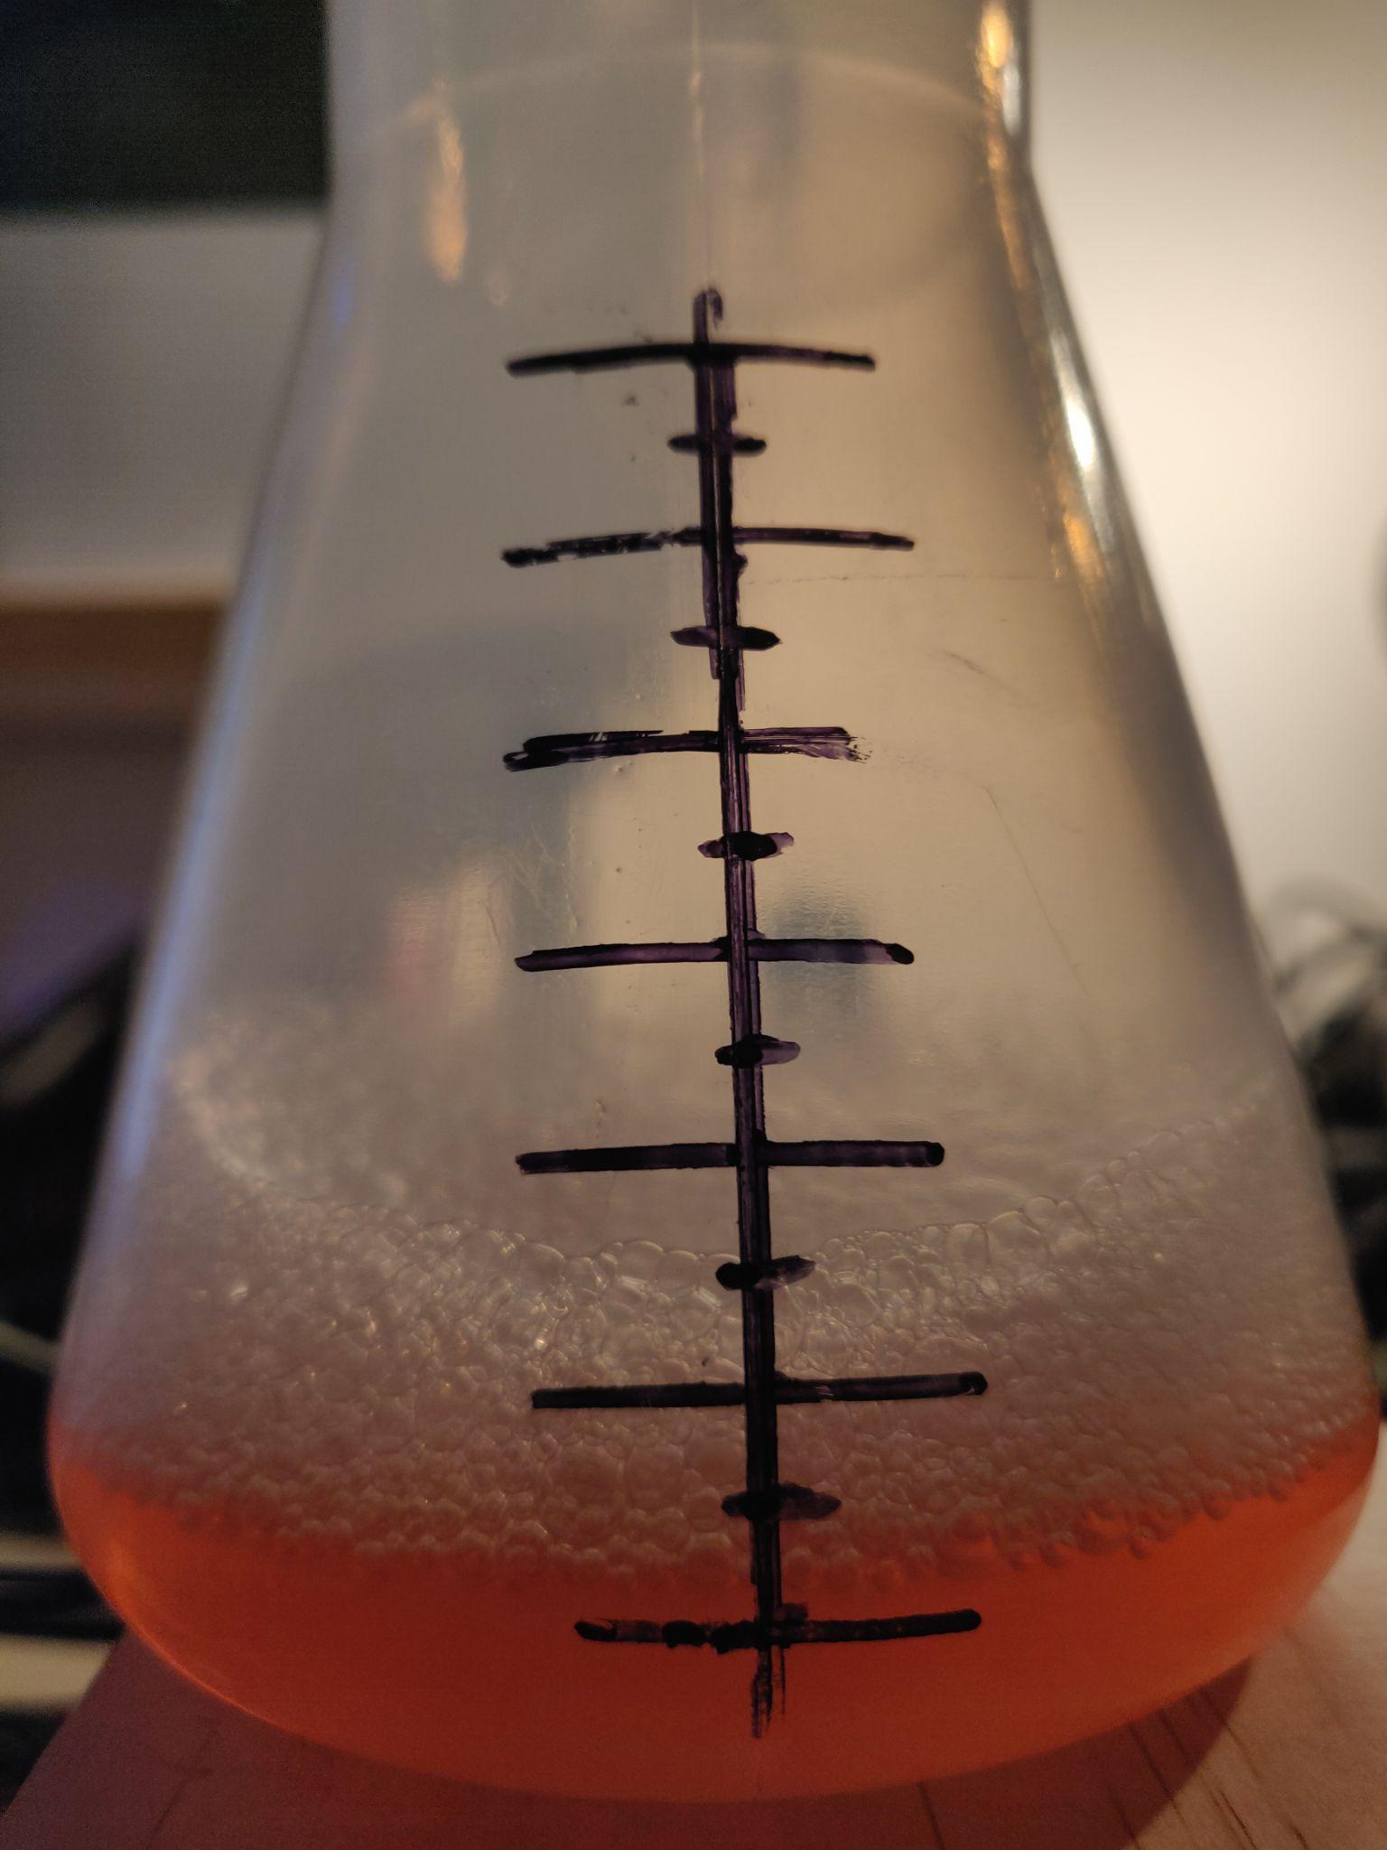
Foam Height Variations
Flat
Flat
Slight height variations

Slide 3

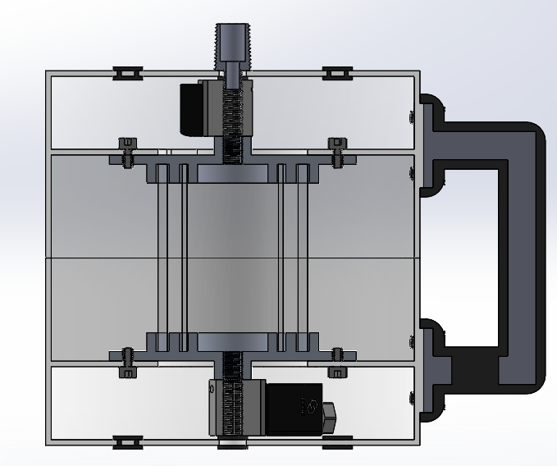
Device Attachment to Reactor’s Tap
(As seen earlier)

Slide 4
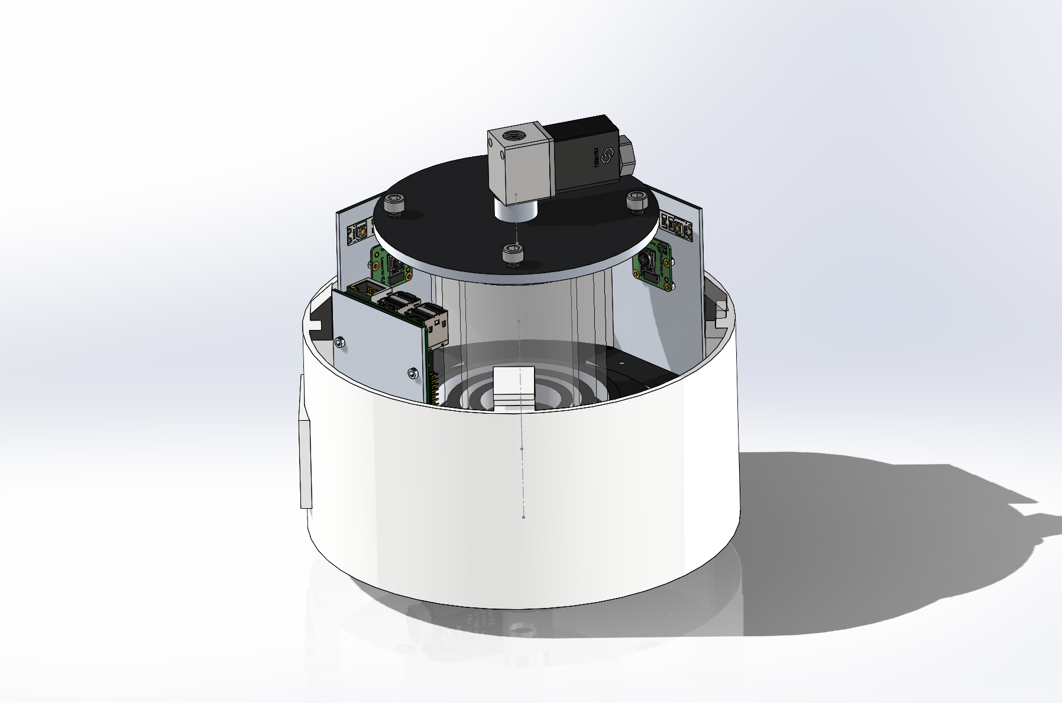
Additional Camera + No Servomotor
2 Pi-Cameras and the Raspberry Pi

Slide 5
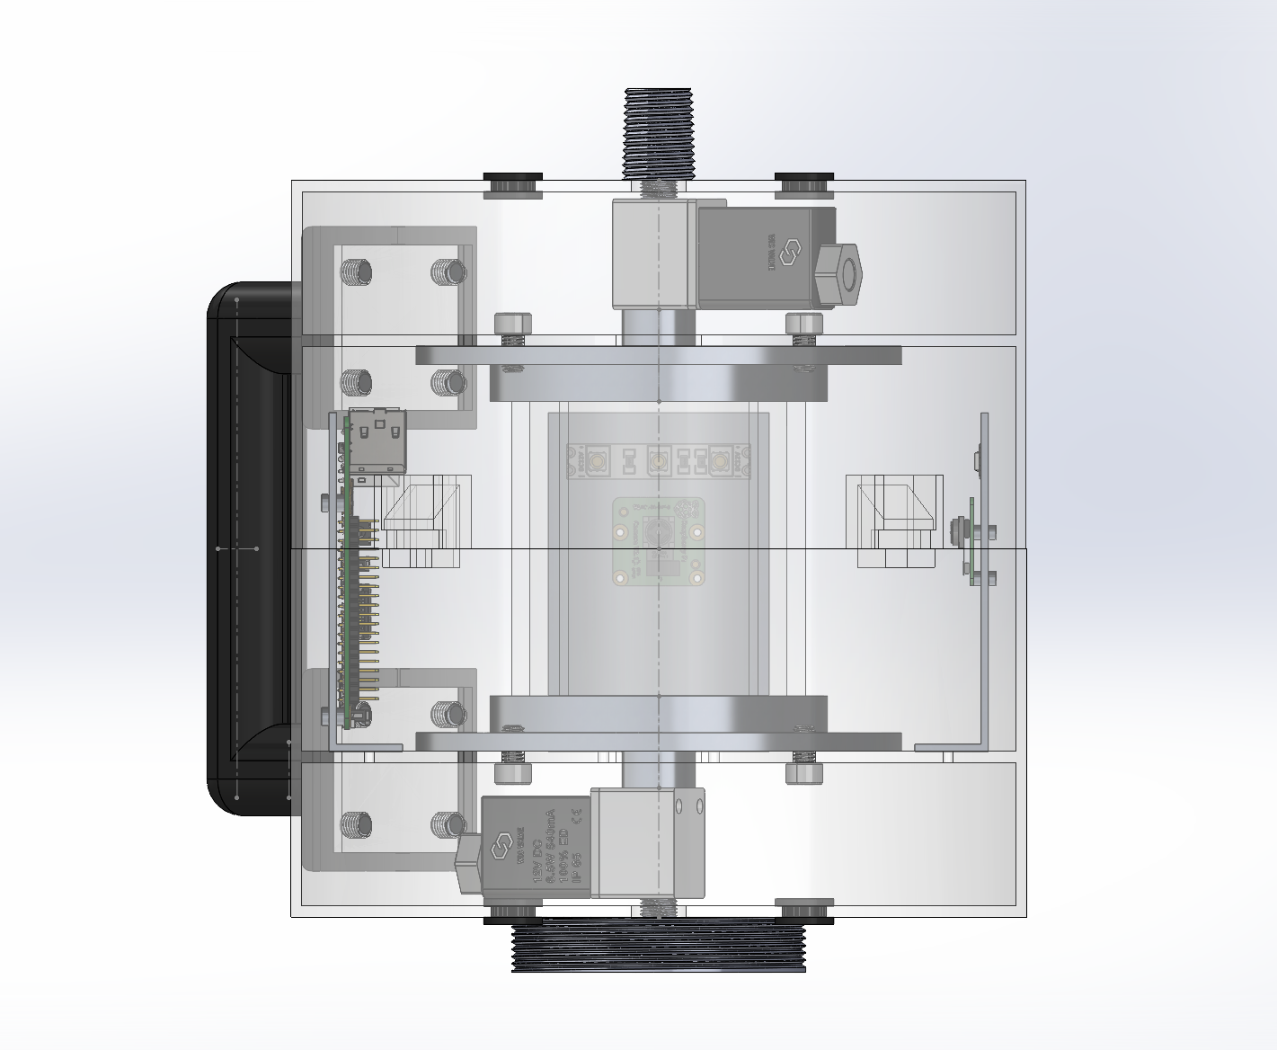
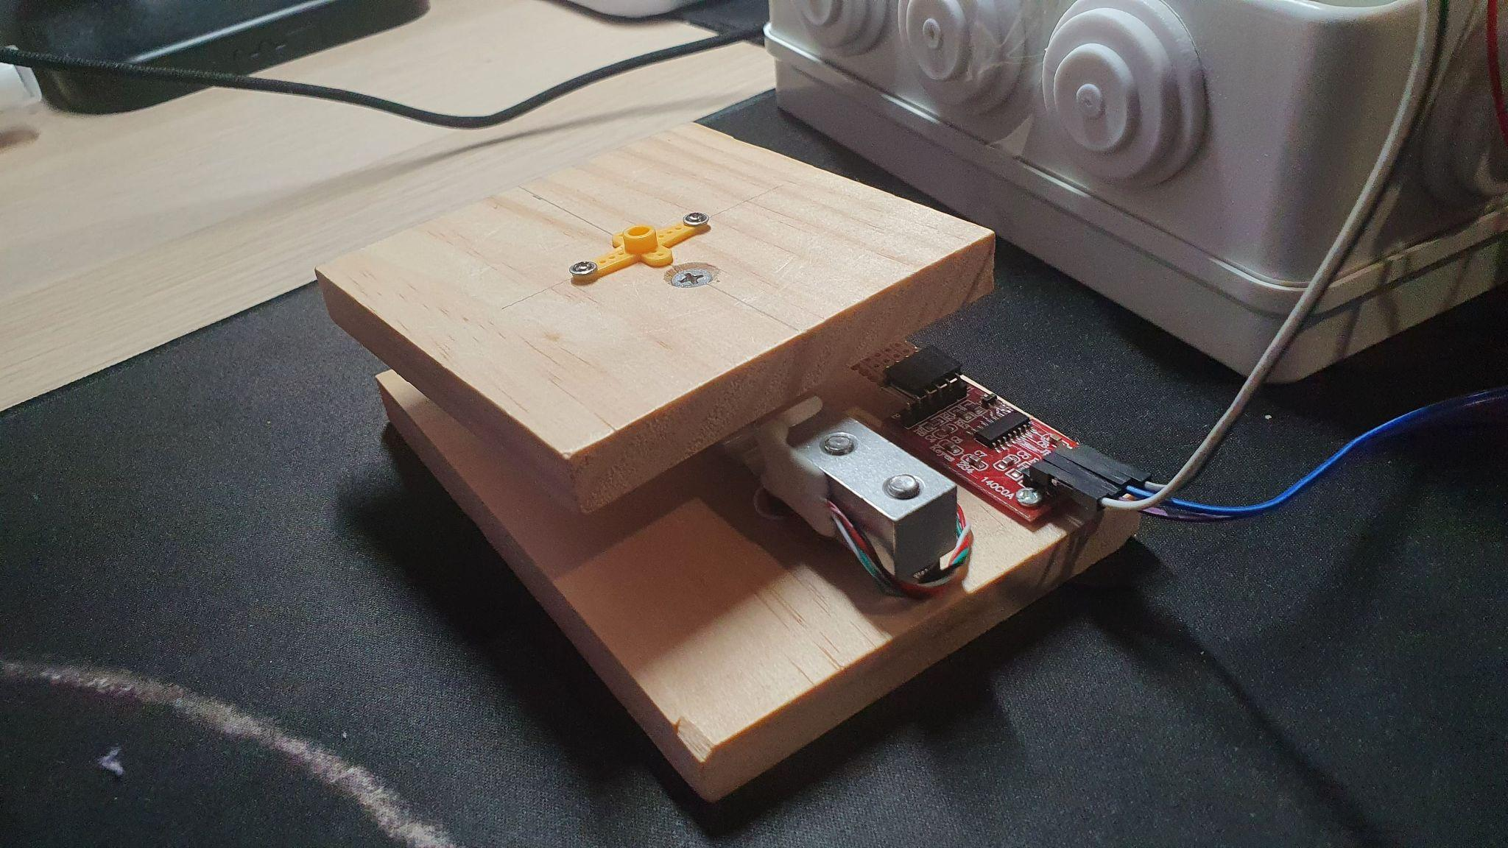
Load Cell
Proof-of-Concept
Prototype Device

